Slide 1
Paragraph organızatıon
Week 5

Slide 2

A Paragraph
Topic sentence(s) for I
Topic sentence(s) for A
Subtopic sentence for A 1
A 1 Card
Comment of the card
Subtopic sentence for A 2
A 2 Card
Comment of the card
Concluding sentence

Slide 3

B Paragraph
Topic sentence(s) for B
Subtopic sentence for B 1
B 1 Card
Comment of the card
Subtopic sentence for B 2
B 2 Card
Comment of the card
Concluding sentence

Slide 4
A SIMPLE TEMPLETE FOR A PARAGRAPH:
Paragraph I A
The first remarkable usage field of /advantage of…………………I………………………….
To begin with / First and foremost /Above all ,.........……………..A…………………………
One of these /For example/ Most important benefits …..………..A1 ………………………..
A1 CARD
Comment of the card
Moreover/ In addition / What is more, …………………………..A2 ………………………...
A2 CARD
Comment of the card
As a result/ For all these reasons/ Consequently,/It can be concluded that ,……….…………..

Slide 5


Paragraph I B
Apart from/ Aside from/ In addition to …… A……, …………….B is advantageous too.
B is also ……………….
B is ………..…..as well.
Most importantly/ Primarily /For example ………………………..B1 …………...………...
B1 CARD
Comment of the card
In addition, Another example / What is more ……………………..B2 ……………………..
B2 CARD
Comment of the card
In brief /Additionally, it can be understood that …………….………………………………..
Concluding sentence
As a result/ For all these reasons/ Consequently,/It can be concluded that ,…………………..

Slide 6
BODY I
Topic sentence(s) for I.
This is the first sentence which summarizes the main idea of the paragraph. When somone reads it ,s/he sould be able to guess what lies ahead. It is an introductory line and it should contain the most important and relevant point regarding your topic.
Topic sentence(s) for A.
This is the second sentence of the paragraph. It usually gives more details about the subdivisions. This part may have a couple of sentences.

Slide 7
BODY I
Subtopic sentence(s) for A1.
It identifies the first major supporting detail and prepares the reader for the notecard.
A1 CARD. It gives information about the the topic with examples and it should start and end with a citation to show the reader where it starts or ends. Cards are usually the experts’ ideas. They are used to support our point of view. The cards include 3-4 sentences. If you include only one sentence long cards ,then your paragraphs can be too short.
Comment of the card
You either choose one out of four types of comments- Deduction, Emphasis, Prediction or Advice- or if your card is quite short, then you can add all comment types one after another.

Slide 8
BODY I
Subtopic sentence(s) for A2.
It identifies the second major supporting detail and prepares the reader for the next notecard.
A2 CARD. It gives further detail. With examples and evidences, you support your topic and subtopic sentences. Depending on the topic, use as many facts, figures, statistics ,stories, anecdotes or quotes as you can.
Comment of the card Again you add your personal idea with clear and simple sentences.
Conclusion
This sentence(s) summarizes the whole paragraph and may restate what has already been stated. It is a kind of paraphrase of the topic sentence of the same paragraph but not a simple rewording it. You have to hit on all of the main ideas,without going off topic. After reading this sentence, the reader should have no doubt as to the accuracy or relevance of the paragraph as a whole.
There is no set lenghth for a paragraph.

Slide 9
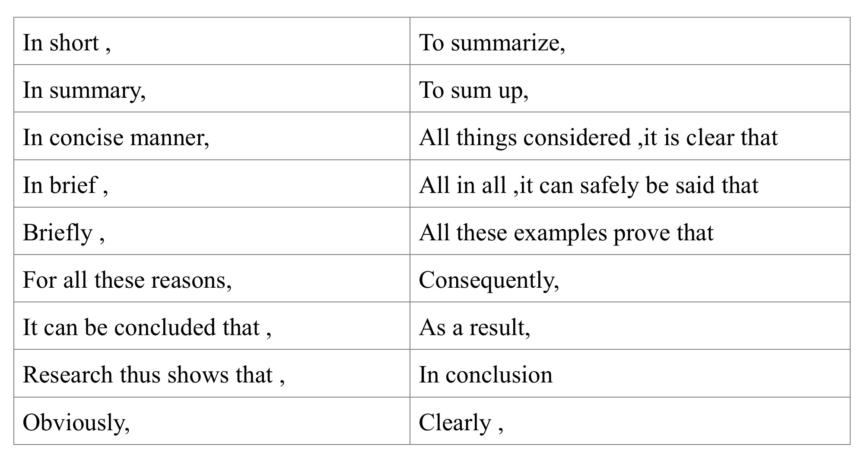
CONCLUDING SENTENCE(S)
Possible phrases you can use for your concluding sentences:

